Slide 1
UI elements in Android Part II

Slide 2
Building Repeatable Layout

Slide 3
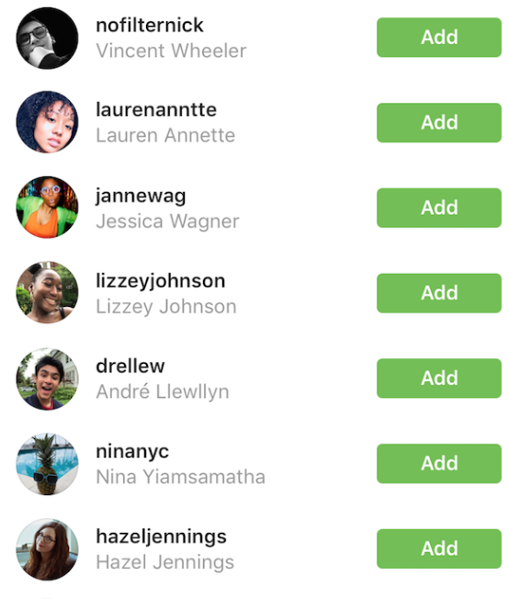
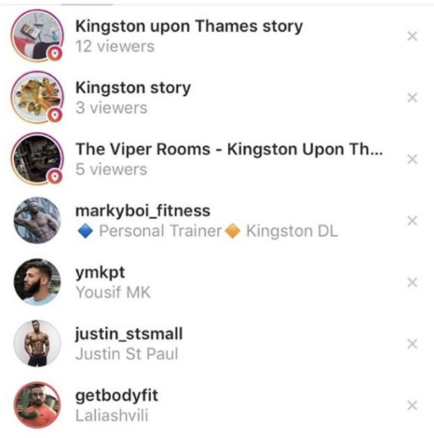

Slide 4
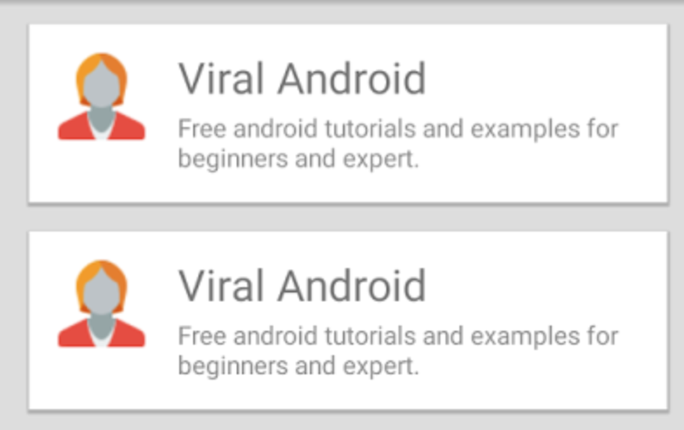

Slide 5

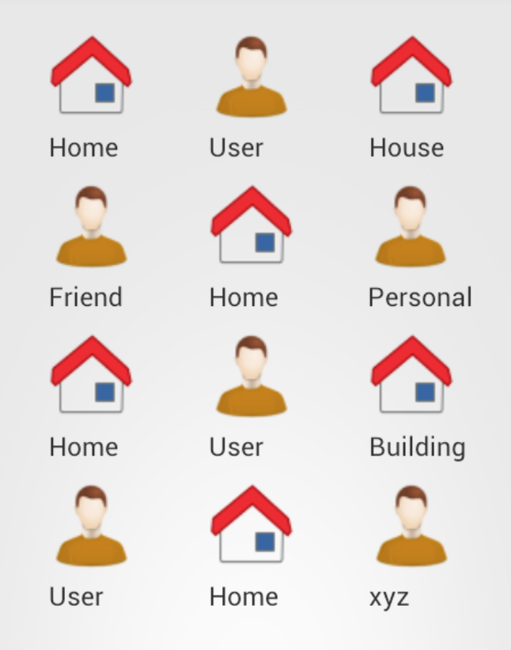

Slide 6


Layout
List View
Displays a scrolling single column list.
Grid View
Displays a scrolling grid of columns and rows.

Slide 7
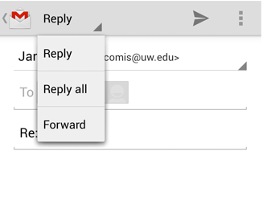
Spinner
Spinner allows you to select an item from a drop down menu

Slide 8
What is needed

Slide 9
1) Data to show
Name
Description
Avatar image

Slide 10
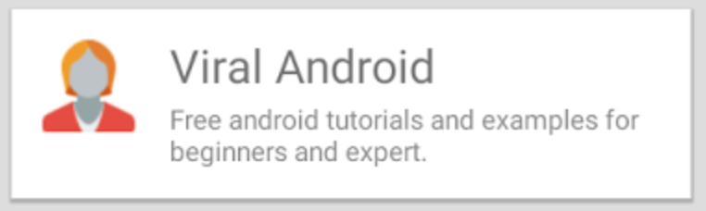
2) View to show data in

Slide 11
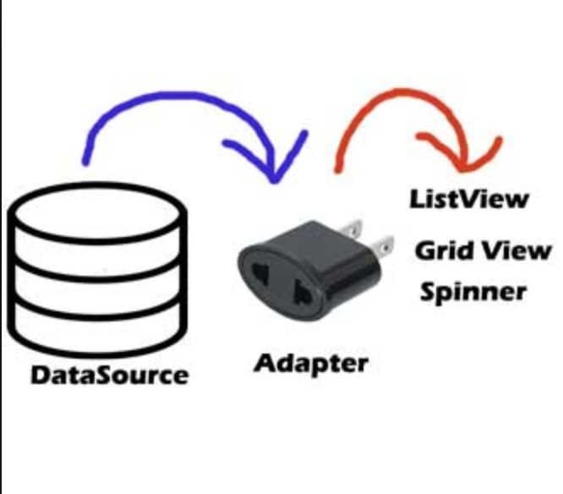
3) Adapter to manage: View←→Data

Slide 12
How it works
Data to display is send to adapter
View that would be used to show data is send to adapter
Adapter takes view and fill it with data and return completed view
ListView/GridView displays that completed view

Slide 13
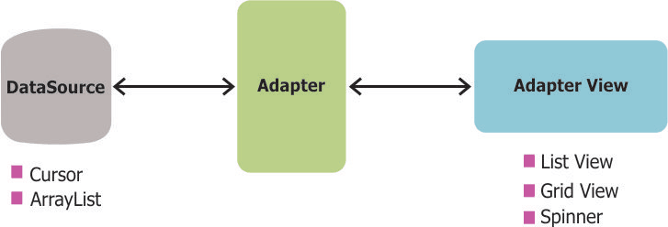

Slide 14
One more thing….

Slide 15
ViewHolder
Remember findViewById()? – its quite an expensive CPU operation.
If you have a lot of items to call findViewById(), every time you prepare a view to show your app would have lags.
In order to overcome that – you could call findViewById() only once, and then store that reference
That is why ViewHolders is used

Slide 16
static class ViewHolder {
TextView cheeseName;
TextView cheeseDescription;
}
In the getView() method, after you inflate the layout, you can now initialize the view holder object using the findViewById() method.
ViewHolder viewHolder = new ViewHolder();
viewHolder.cheeseName = (TextView)convertView.findViewById(R.id.cheese_name);
viewHolder.cheeseDescription = (TextView)convertView.findViewById(R.id.cheese_description);

Slide 17
To store the view holder object in convertView, use its setTag() method.
// Store results of findViewById
convertView.setTag(viewHolder);
And now, every time getView() is called, you can retrieve the view holder object from convertView using the getTag() method and update the TextView widgets inside it using their setText() methods.
TextView cheeseName =
((ViewHolder)convertView.getTag()).cheeseName;
TextView cheeseDescription =
((ViewHolder)convertView.getTag()).cheeseDescription;
cheeseName.setText(currentCheese.name);
cheeseDescription.setText(currentCheese.description);

Slide 18
Adapter

Slide 19
Adapter
An Adapter object acts as a bridge between an AdapterView and the underlying data for that view. The Adapter provides access to the data items. The Adapter is also responsible for making a View for each item in the data set.
An adapter is responsible for retrieving data from the data set and for generating View objects based on that data. The generated View objects are then used to populate any adapter view that is bound to the adapter.

Slide 20
Create data array in array strings
<?xml version="1.0" encoding="utf-8"?> <resources> <string-array name="planets_array"> <item>Mercury</item> <item>Venus</item> <item>Earth</item> <item>Mars</item> <item>Jupiter</item> <item>Saturn</item> <item>Uranus</item> <item>Neptune</item> </string-array> </resources>

Slide 21
Responding to User Selections
When the user selects an item from the drop-down, the Spinner object receives an on-item-selected event.
To define the selection event handler for a spinner, implement the AdapterView.OnItemSelectedListener interface and the corresponding onItemSelected() callback method. For example, here's an implementation of the interface in an Activity:

Slide 22
OnitemSelectedlLstener
public class SpinnerActivity extends Activity implements OnItemSelectedListener { ... public void onItemSelected(AdapterView<?> parent, View view, int pos, long id) { // An item was selected. You can retrieve the selected item using // parent.getItemAtPosition(pos) } public void onNothingSelected(AdapterView<?> parent) { // Another interface callback } }

Slide 23
How Do Adapter Views Work?
Adapter views can display large data sets very efficiently. For instance, the ListView and GridView widgets can display millions of items without any noticeable lag while keeping memory and CPU usage very low. How do they do that? Different adapter views follow different strategies. However, here's what most of them usually do.
They render only those View objects that are either already on-screen or that are about to move on-screen. This way, the memory consumed by an adapter view can be constant and independent of the size of the data set.
They also allow developers to minimize expensive layout inflate operations and recycle existing Viewobjects that have move off-screen. This keeps CPU consumption low.

Slide 24
Creating an ArrayAdapter
To create an adapter, you need the following:
a data set
a resource file containing the layout of the generated View objects
Additionally, because the ArrayAdapter class can only work with strings, you need to make sure the layout of the generated View objects contains at least one TextView widget.

Slide 25
Create the Data Set
The ArrayAdapter class can use both arrays and List objects as data sets.
String[] cheeses = {
"Parmesan",
"Ricotta",
"Fontina",
"Mozzarella",
"Cheddar"
};

Slide 26
Create the layout File
<?xml version="1.0" encoding="utf-8"?>
<LinearLayout xmlns:android="http://schemas.android.com/apk/res/android"
android:orientation="vertical" android:layout_width="match_parent"
android:layout_height="match_parent”>
<TextView
android:layout_width="wrap_content"
android:layout_height="wrap_content"
android:textAppearance="?android:attr/textAppearanceLarge"
android:text="Large Text"
android:id="@+id/cheese_name" />
</LinearLayout>

Slide 27
Create the Adapter
ArrayAdapter<String> cheeseAdapter =
new ArrayAdapter<String>(this,
R.layout.item,
R.id.cheese_name,
cheeses
);
In your activity, create a new instance of the ArrayAdapter class using its constructor. As its arguments, pass the name of the resource file, the identifier of the TextView, and a reference to the array. The adapter is now ready.

Slide 28
Creating a List View
To display a vertically scrollable list of items, you can use the ListView widget. To add the widget to your activity, you can either drag and drop it inside the activity's layout XML file or create it using its constructor in your Java code.
ListView cheeseList = new ListView(this);
setContentView(cheeseList);
cheeseList.setAdapter(cheeseAdapter);

Slide 29
Grid View
To display a vertically scrollable two-dimensional grid of items, you can use the GridView widget. Both ListView and GridView are subclasses of the abstract AbsListView class and they share many similarities. Therefore, if you know how to use one, you know how to use the other as well.

Slide 30
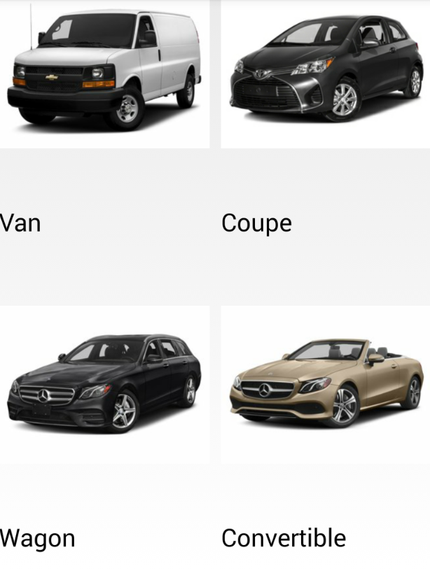
TODO & Homework:
Requirements :
Grid View
Custom view to show cars
Class for Cars (that holds name & img)
Class for Cars ViewHolder
When press on item – show toast with car type name

Slide 31
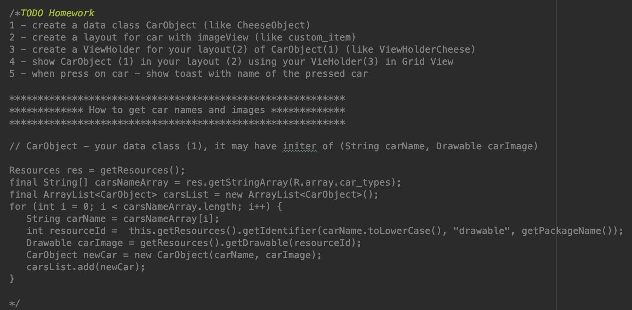
Lecture 3 - MainActivity

